Slide 2
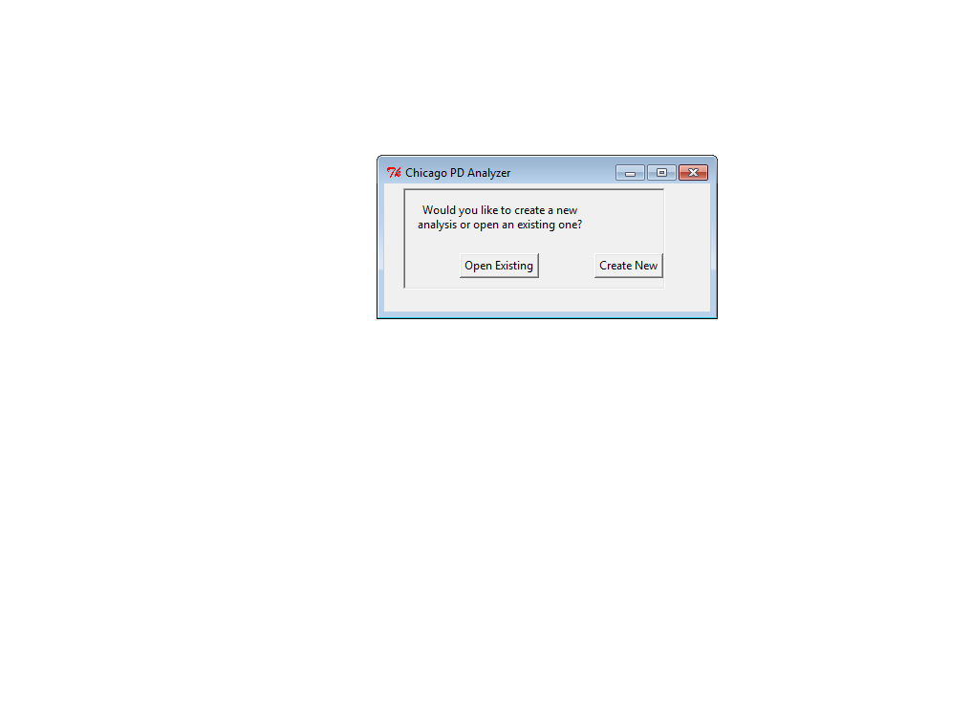

Slide 3
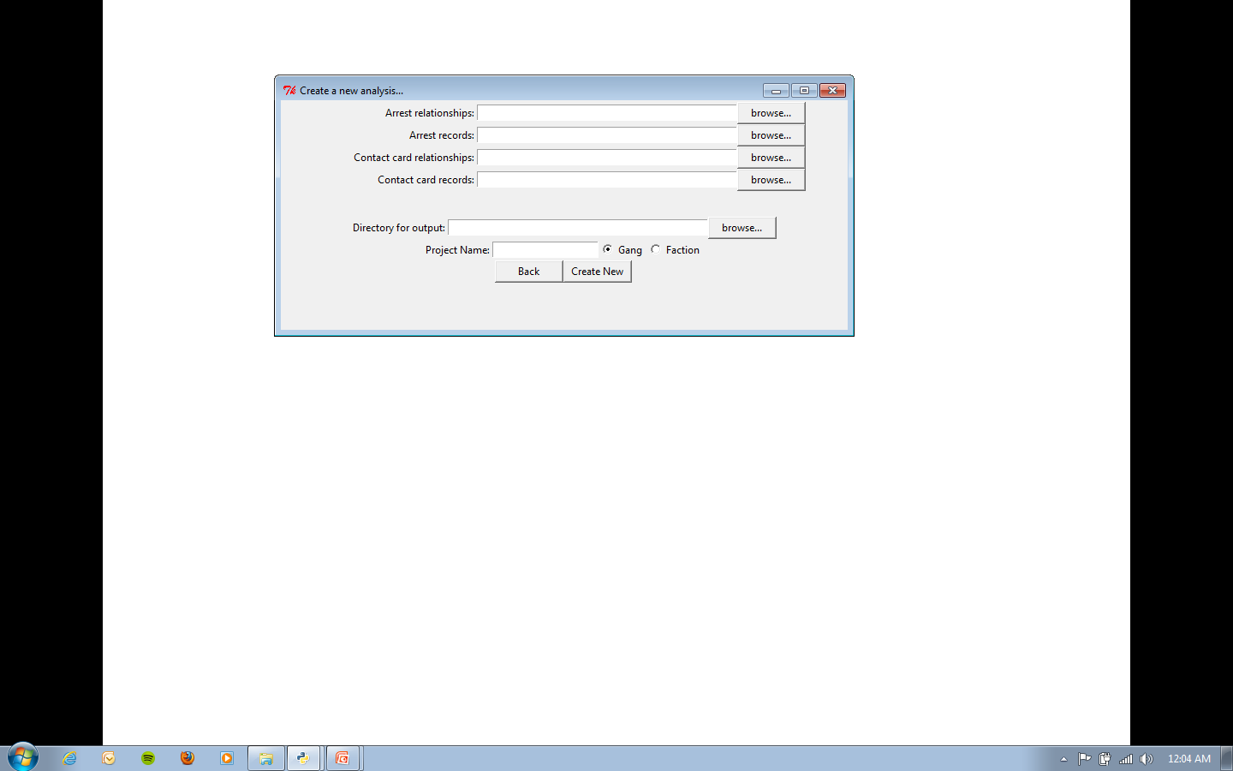
Create New Analysis
The program analyzes connections between arrests and (optionally) contact cards.

Slide 4
Click “browse…” or type in the path to the arrest records.

Slide 5
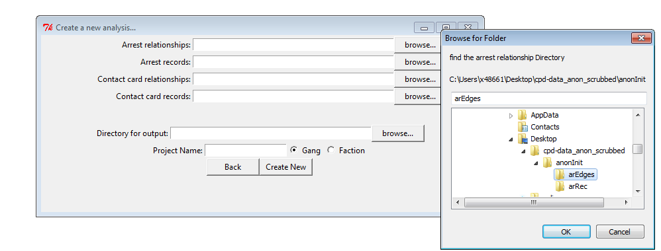
Click ok and repeat for Arrest records

Slide 6
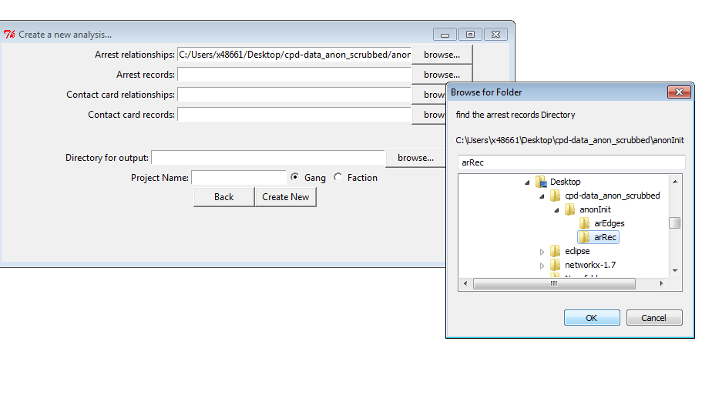
Click Ok

Slide 7
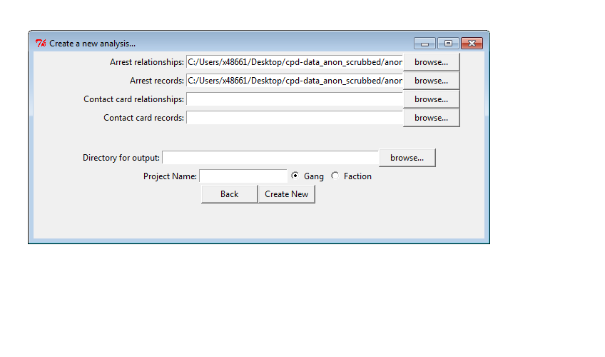
Contact Cards can be left blank or filled in like previous slides

Slide 8
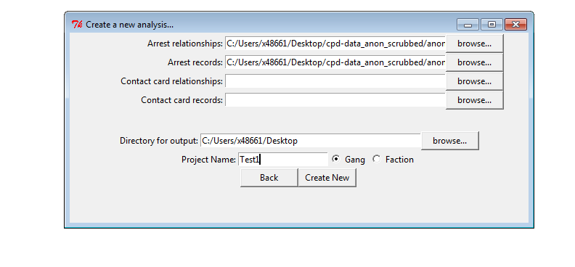
-Select an output directory and name your analysis by date (eg 03JUL13).
-Successive analysis on the same day should be named with an alpha designation (eg 03JUL13a).
-Select whether you would like to analyze the records by gang or gang faction
-Click create New

Slide 9
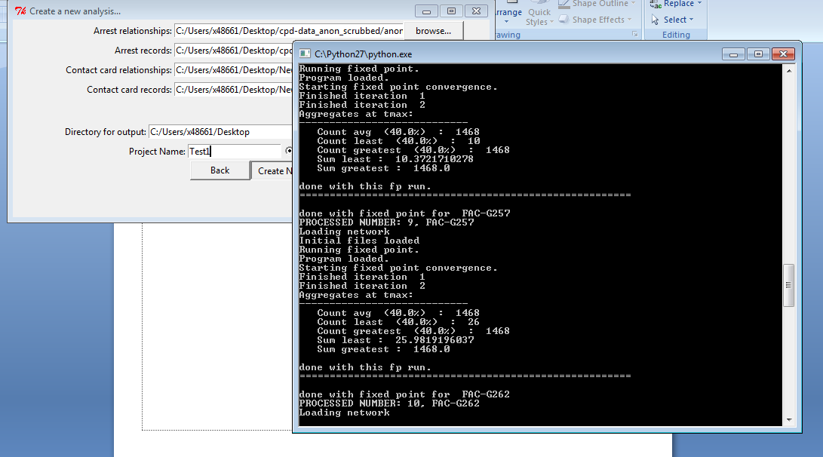
Let it run… (<3 minutes) You should see something like this scrolling quickly

Slide 10
When done, it will bring you to the following main menu.

Slide 11
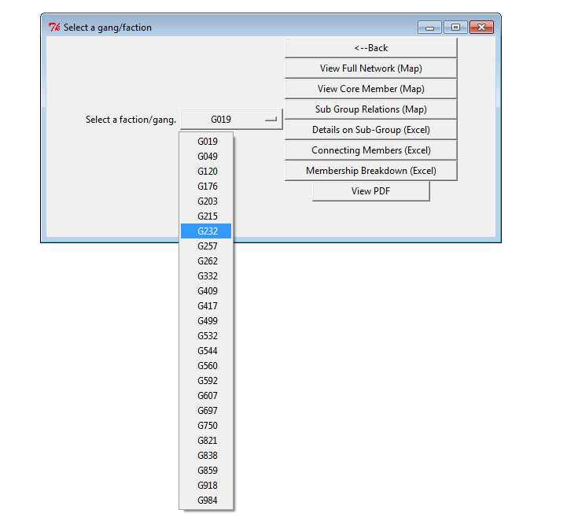
“View Full Network” (1st Button)

Slide 12
Viewing the plots
The nodes (dots) represent people and the edges (lines) represent an arrest together between people
Larger nodes= more arrest relationships
Color coded by subgroup as determined by analysis
Nodes can be clicked for IR number and probability of membership in gang(ie .62 = 62%)

Slide 13
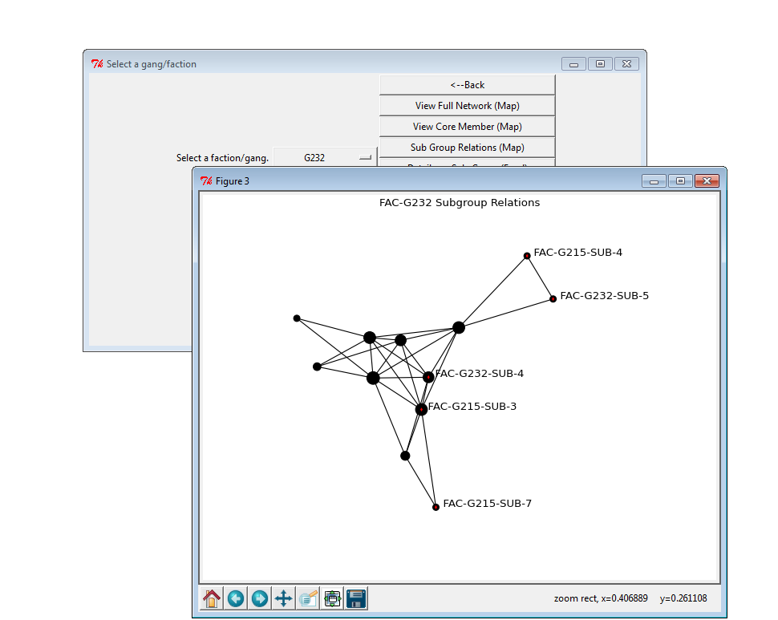
View Subgroup Relations (3rd Button)
Each circle is a sub-group, not an individual, to show interactions between sub-groups

Slide 14
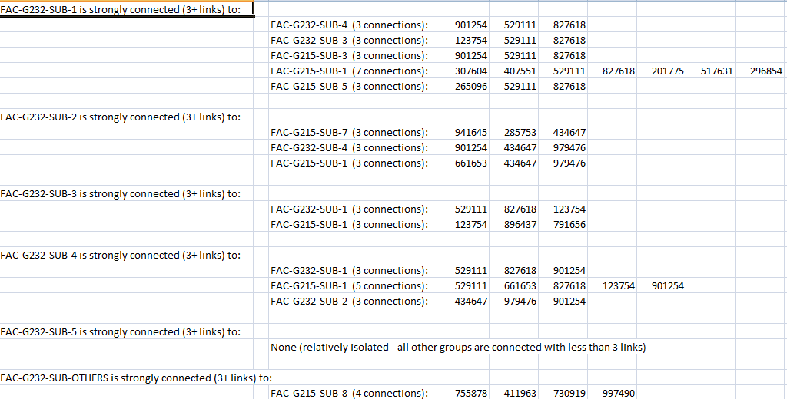
DETAILS ON SUB-GROUP (EXCEL)
Will Open up Excel to show connections between subgroups

Slide 15
DETAILS ON SUB-GROUP (EXCEL)
Will Open up Excel to show connections between subgroups

Slide 16
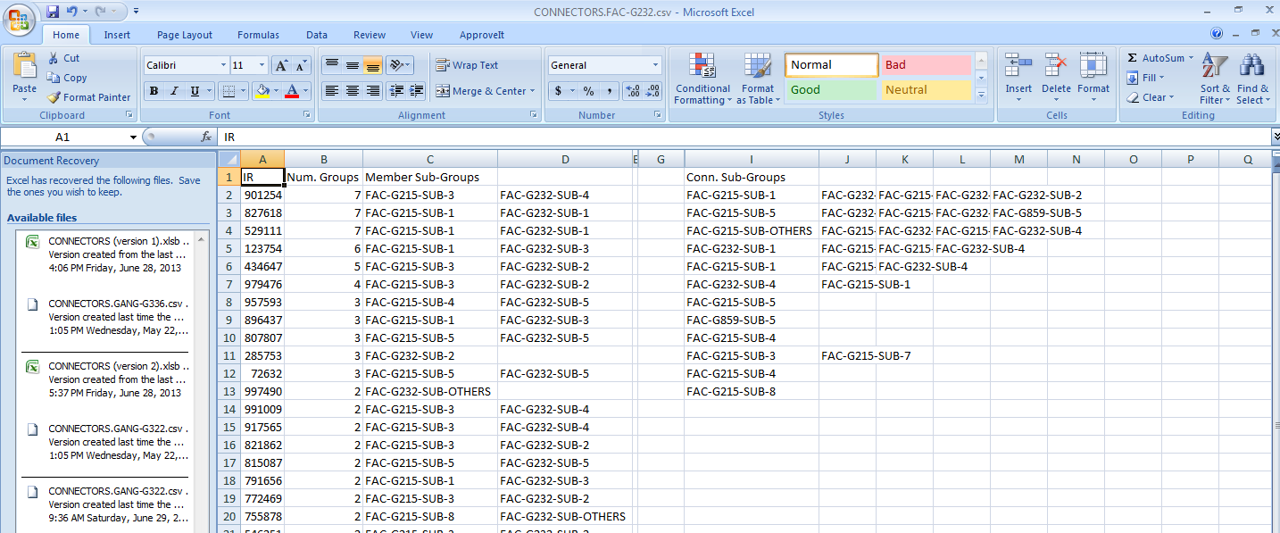
Connecting Members(Excel)
By IR number, displays the groups that person is a member of as well as the groups they are connected to.
In instances where an IR number is shown as being part of two groups, that person has equal number of connections to both groups.

Slide 17
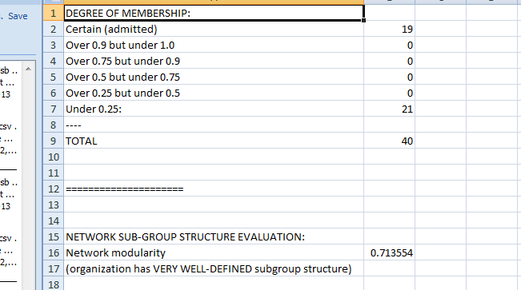
Membership Breakdown(Excel)
Breaks down numbers by probability of membership where 1.0 is self-admitted. Probabilities are determined by the analysis through arrest relationships
Network modularity refers to the groups subgroup definition.

Slide 18
View PDF & Tactical PDF
“View PDF” will generate a 7-45 page PDF report in 10-60 seconds depending on gang size.
“Tactical PDF” will generate a more summarized 4-8 page PDF report in 5-30 seconds depending on gang size.

Slide 19
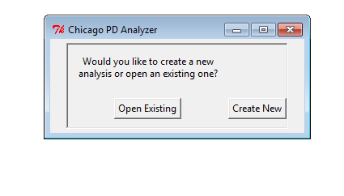
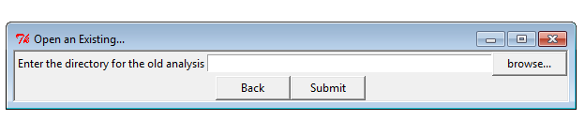
To open an existing analysis…
Click Browse…

Slide 20
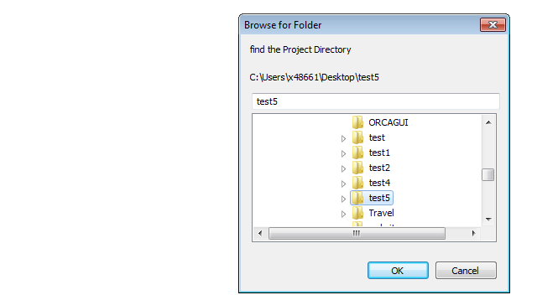
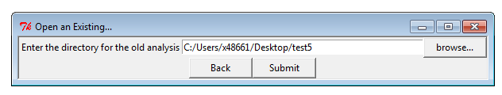
Select the name of the analysis (eg “test5”) and click ok
Click Submit

Slide 21
You’ll be brought back to the main menu if you correctly selected the right folder.

